Slide 1
Capstone Progress Meetings
Sirish Desai, Stephanie Landas, Noah Edwards-Thro, Michelle Wu

Slide 2
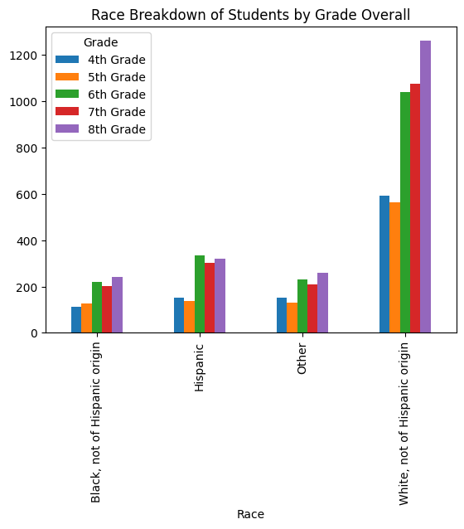
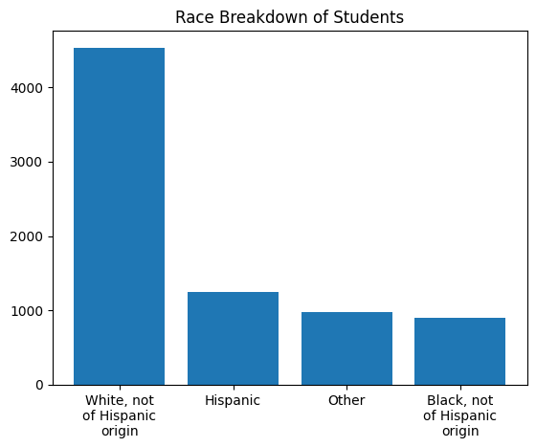
EDA w/ Race

Slide 3
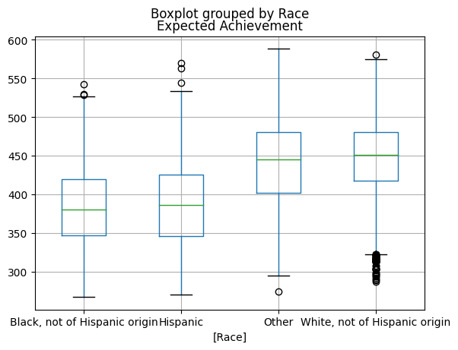
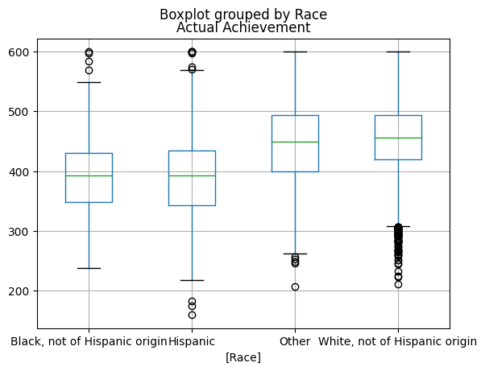
Race and Expected/Actual Achievement

Slide 4
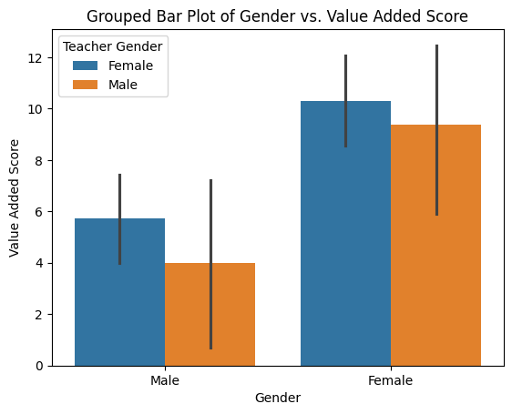
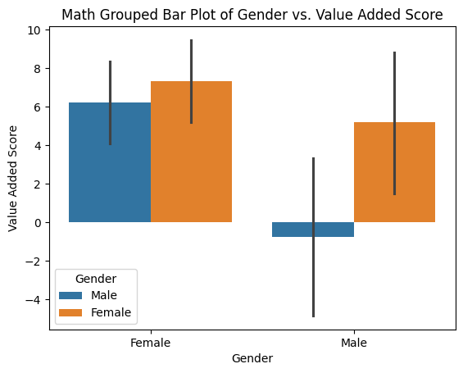
Read Dataset EDA by Gender (Teacher and Student)

Slide 5
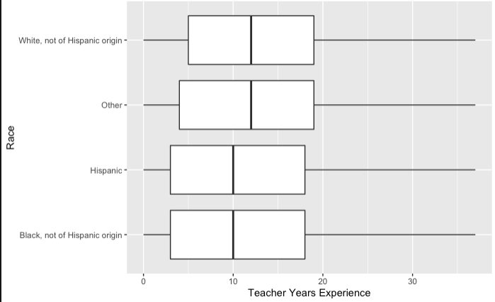
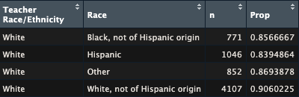
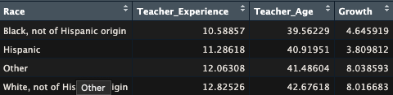
Full Dataset EDA by Race with Teacher

Slide 6
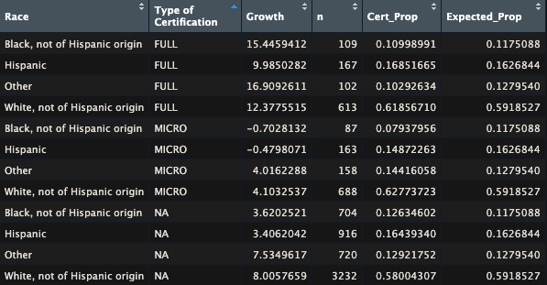
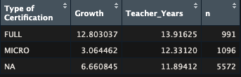
Full Dataset EDA by Certification Type

Slide 7
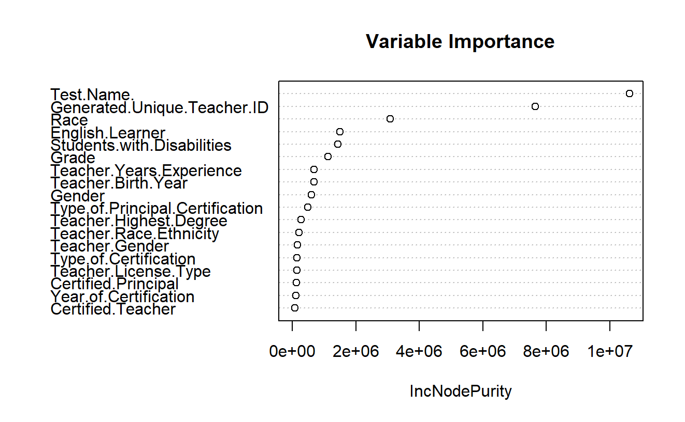
Random Forest (Math dataset, y = Vertical Scaled Score)
Shows test, specific teachers, race of student, and whether students are english learners as high importance

Slide 8
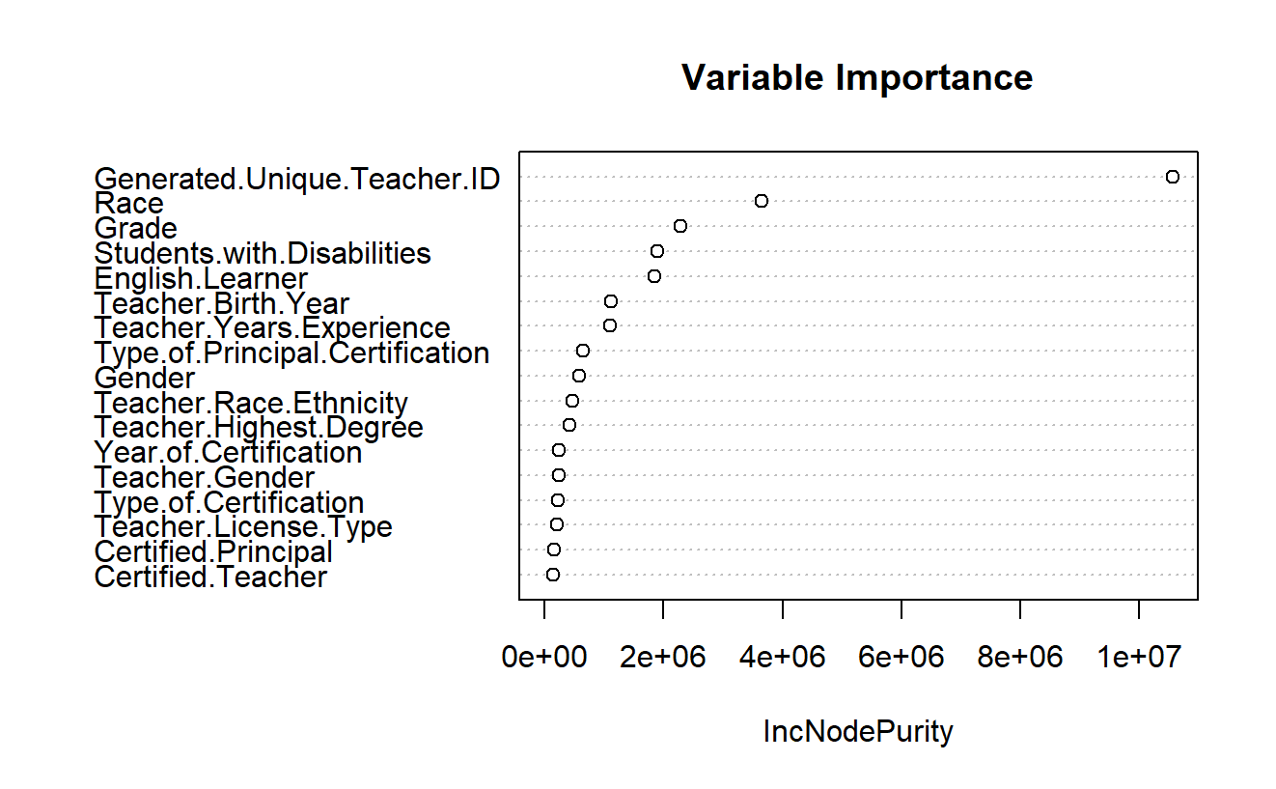
Random Forest (Math dataset, y = Vertical Scaled Score)
Shows specific teachers, race of student, and whether students are english learners as high importance

Slide 9
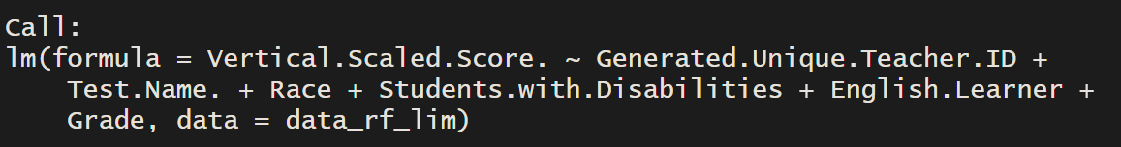
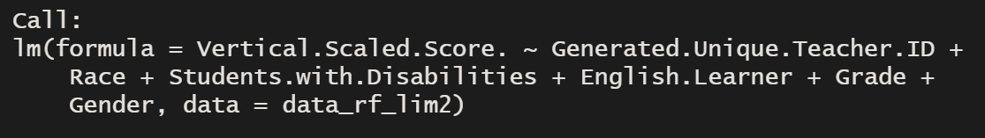
Stepwise Lin Reg (Math dataset, y= Vertical Scaled Score)
Once test name is dropped, gender of student is added:
All statistically significant coefficients for teacher ID (44/46) are negative. There are 2 non-statistically significant positive coefficients.

Slide 10
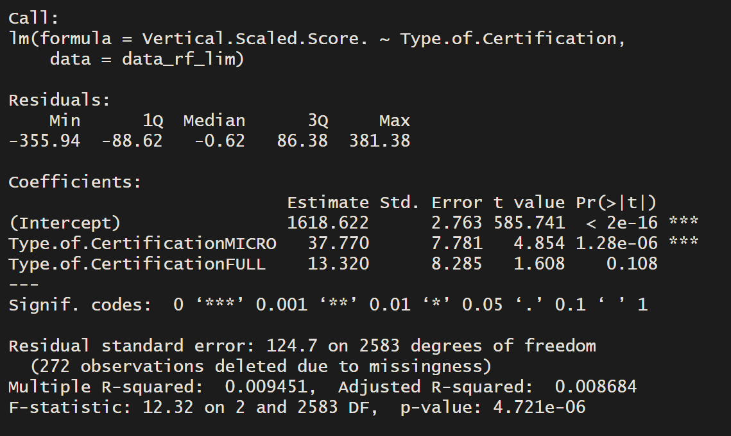
Math dataset (simple linear regression)
When just considering teacher certification, there is a positive impact on vertical scaled score, though only the micro-certification is statistically significant.

Slide 11
2nd Meeting

Slide 12
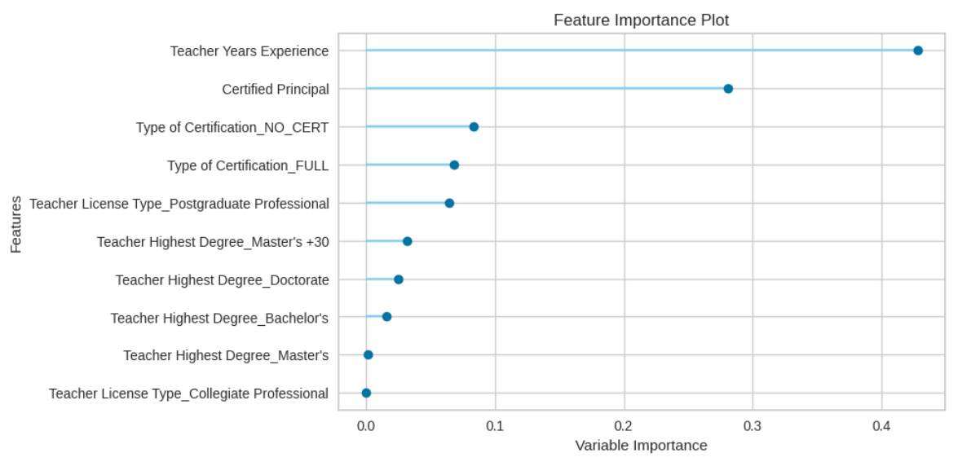
Decision Tree - Math Dataset: Growth vs. Certification (Teacher and Principal)
Teacher years experience has the highest weight

Slide 13
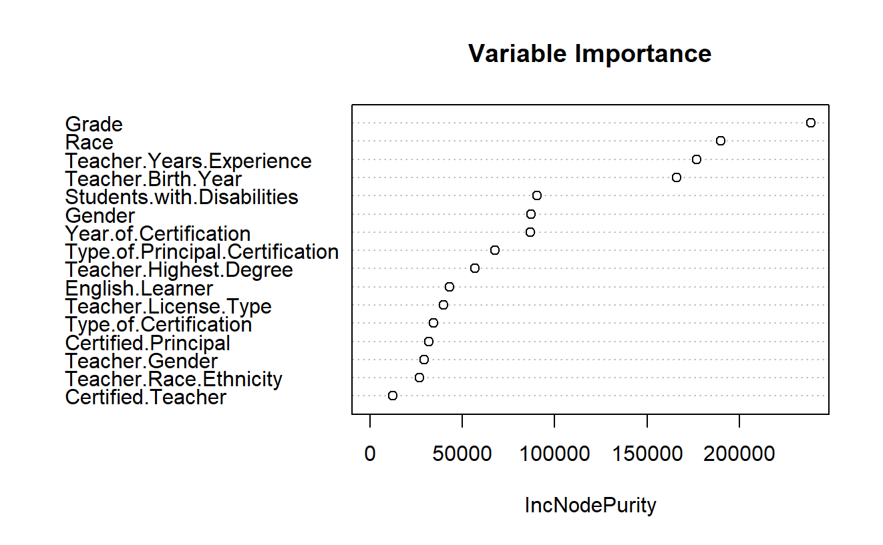
Random Forest on Growth (math dataset with 5th graders)
Does not include test name, generated teacher ID as predictors; removed other possible outcomes (vertical scaled score, etc.)

Slide 14
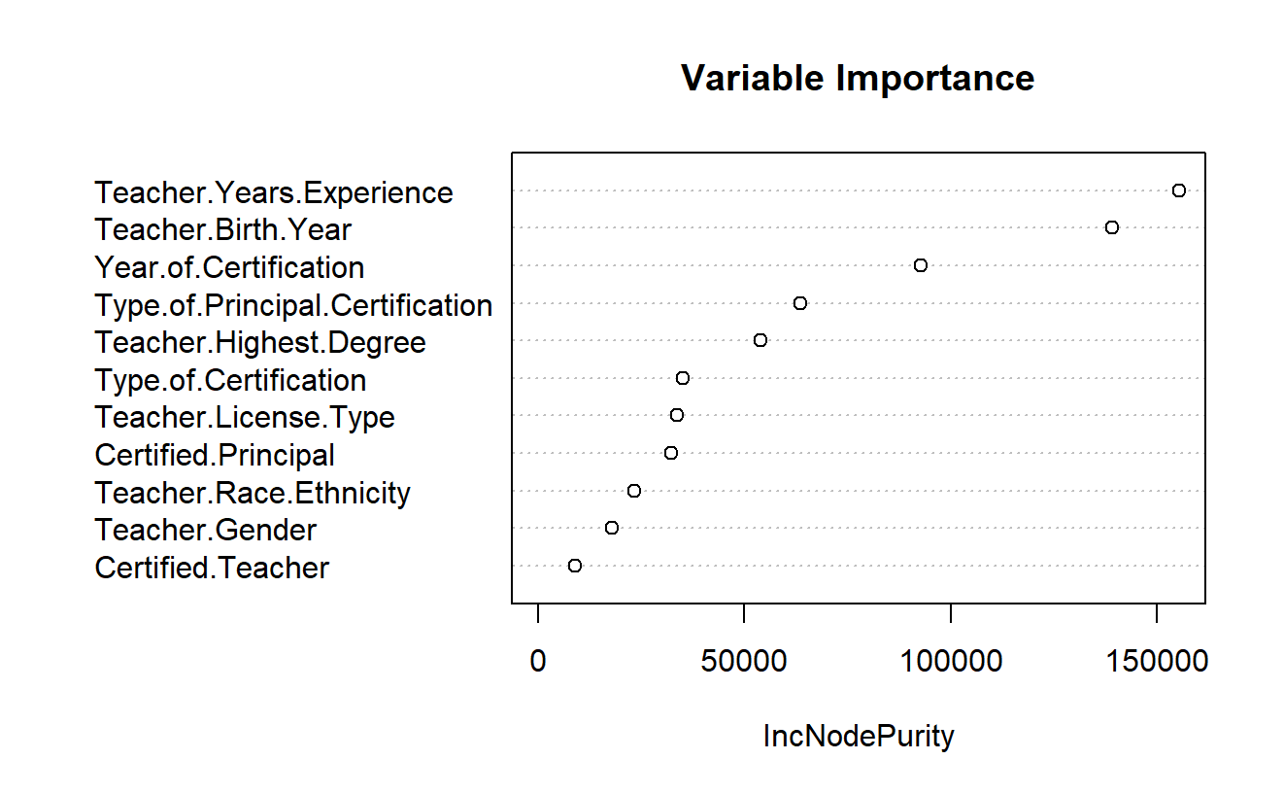
Random Forest on Growth (math dataset with 5th graders)
Does not include student demographic information.

Slide 15
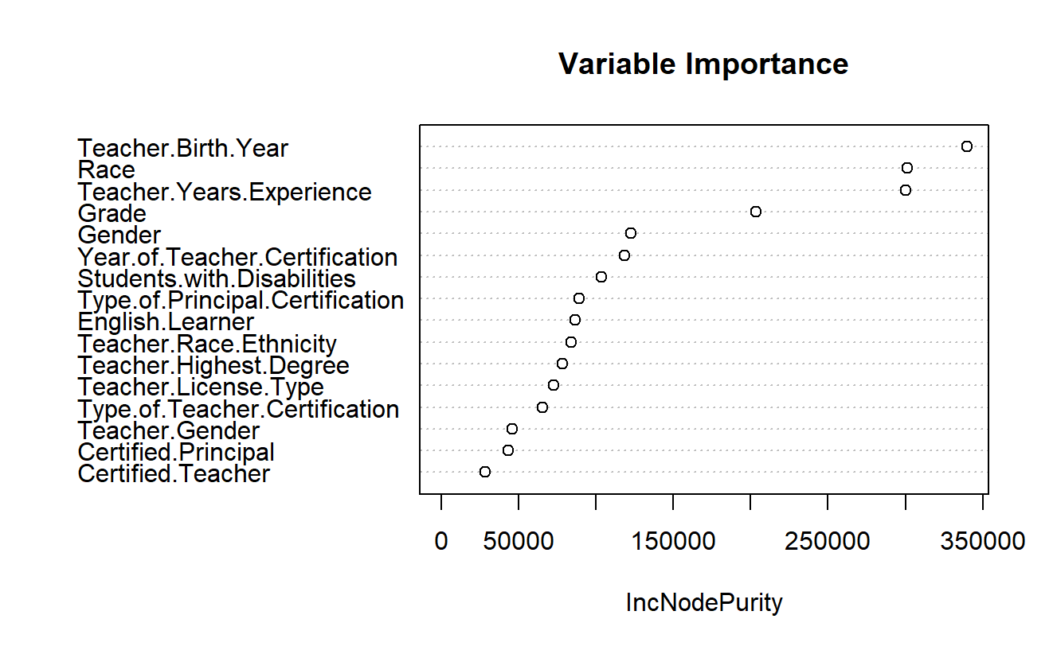
Random Forest on Growth (reading dataset)
Does not include test name, generated teacher ID as predictors; removed other possible outcomes (vertical scaled score, etc.)

Slide 16
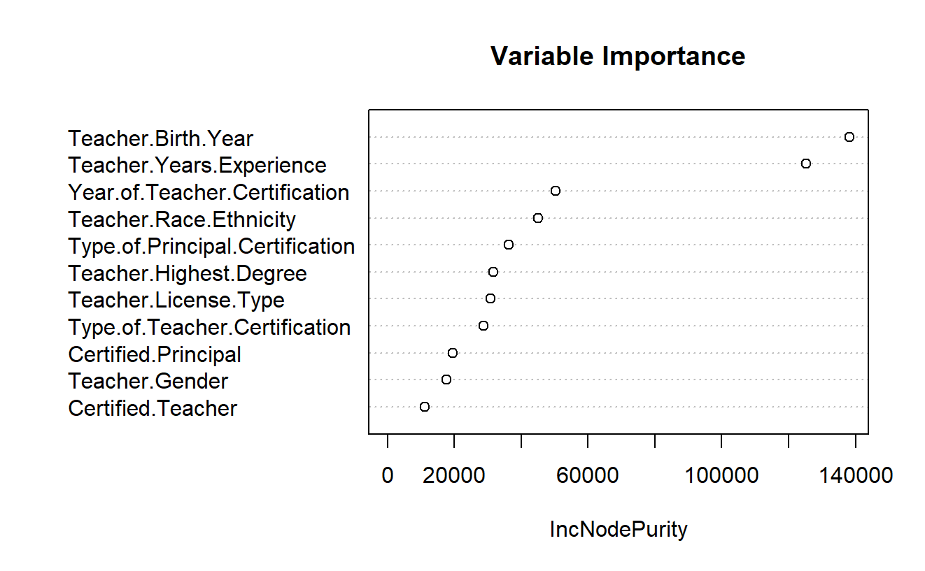
Random Forest on Growth (reading dataset)
Does not include student demographic information.

Slide 17
3rd Meeting

Slide 18
Teacher Certification & Growth only

Slide 19
What’s true about the data?
Considered a one-way ANOVA test
One-way test is used to compare one categorical variable (usually of three groups or more) on one numeric/continuous variable.
Tests only if any of the groups have a statistically significant effect on the dependent variable, but cannot tell us which group within the categorical variable.
Data must have: normal distribution, sample independence, variance equality.
But:
Data isn’t normally distributed

Slide 20
Kruskal-Wallis Test
The one-way ANOVA test for non-normal distributions.
Tests only if any of the groups have a statistically significant effect on the dependent variable, but cannot tell us which group within the categorical variable.
Dunn’s test will determine whether each category is statistically significant.

Slide 21
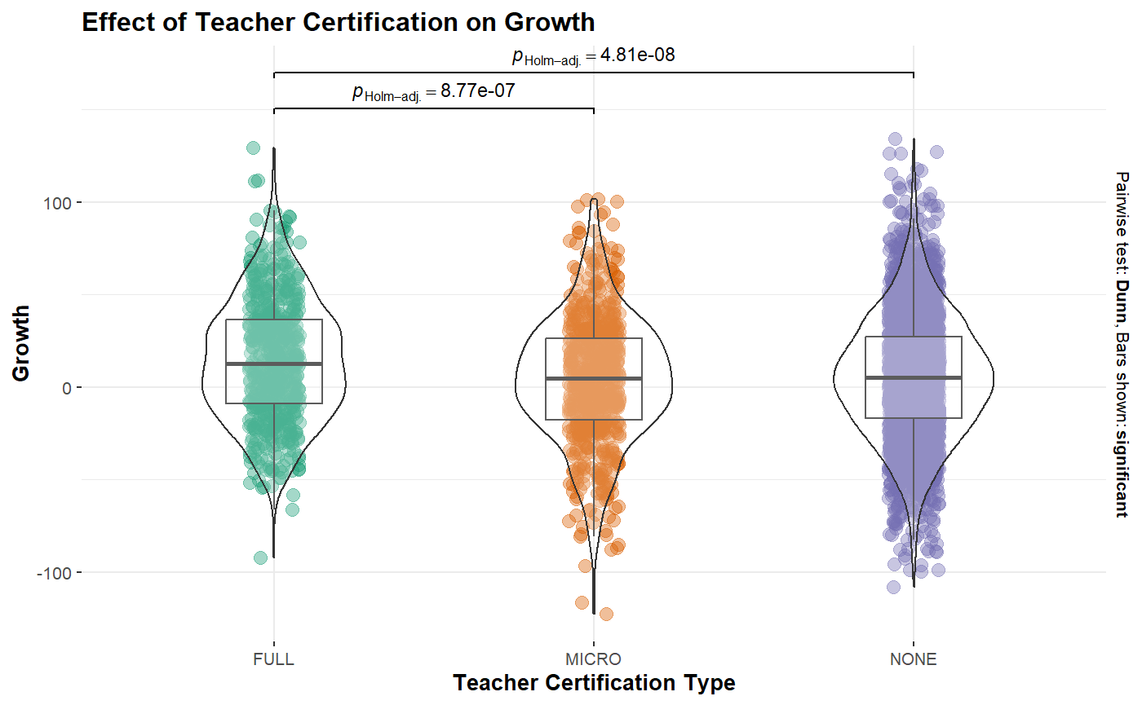
Kruskal-Wallis Test -- Math Dataset
There is a statistically significant effect of teacher certification on student growth.
For the math dataset, there is a statistically significant difference between the full and micro certifications, and the full and none certifications.

Slide 22
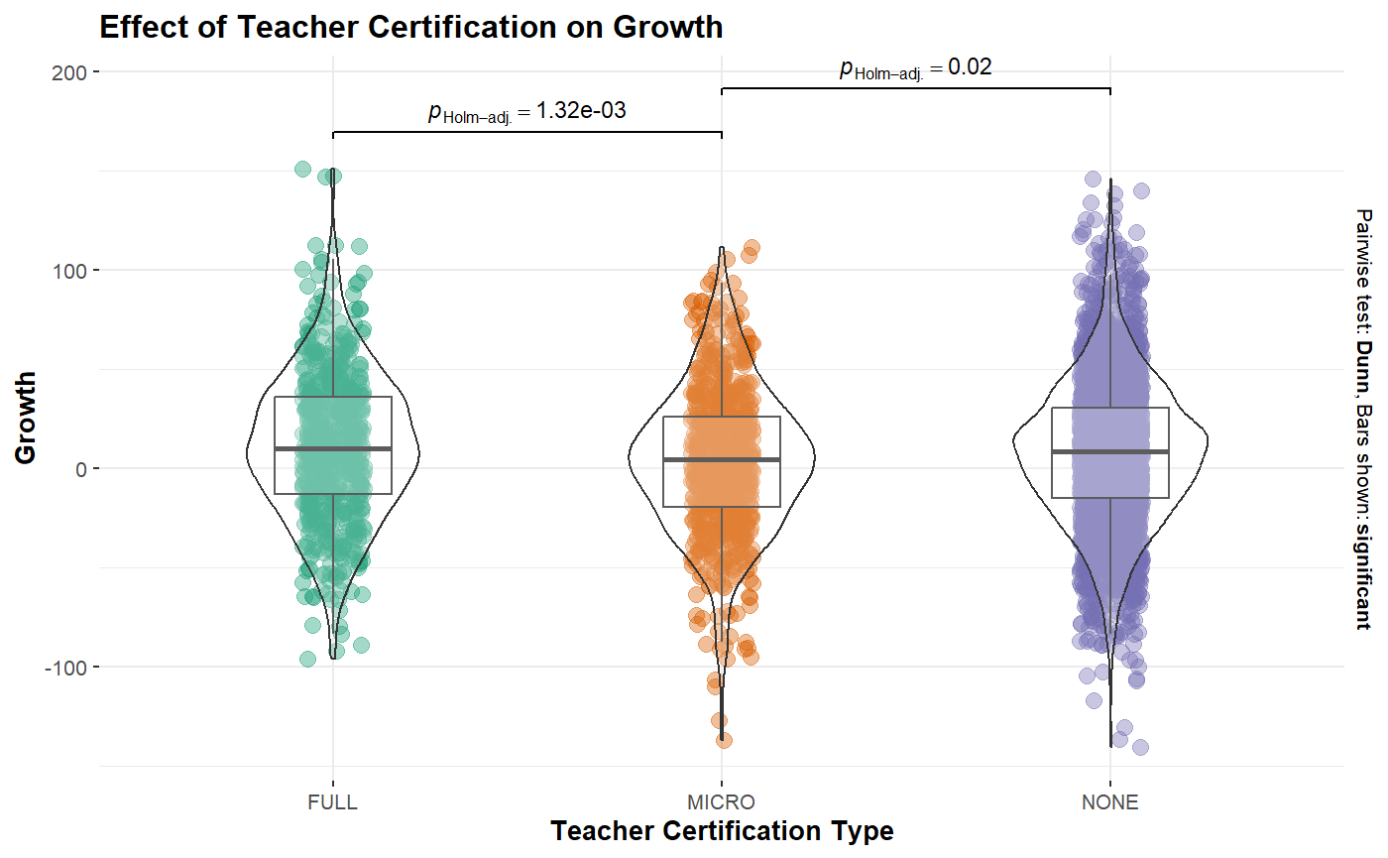
Kruskal-Wallis Test -- Reading Dataset
There is a statistically significant effect of teacher certification on student growth.
For the reading dataset, there is a statistically significant difference between the full and micro certifications, and the micro and none certifications.

Slide 23
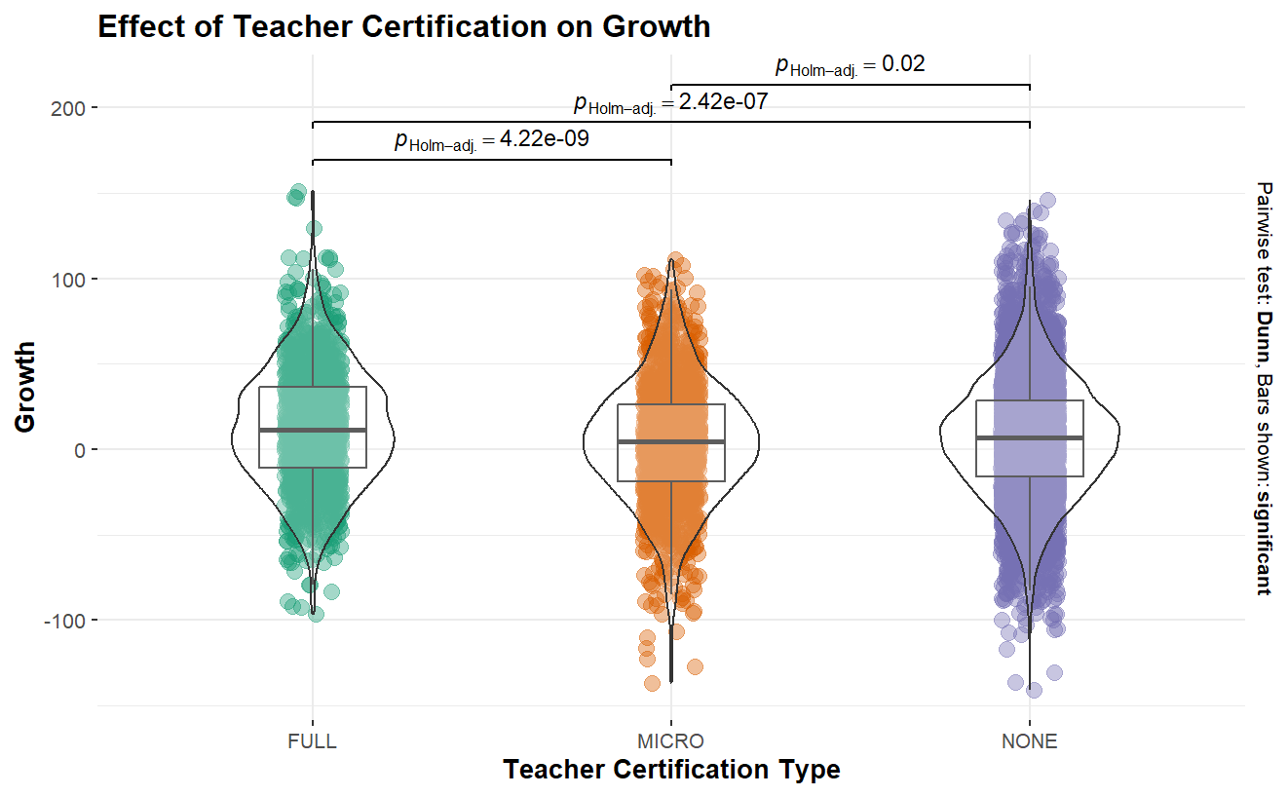
Kruskal-Wallis Test -- Overall
There is a statistically significant effect of teacher certification on student growth.
For the reading dataset, there is a statistically significant difference between all certification types.
Notes:
This difference is most likely due to the sample size (9520 overall vs 4719 in math and 4801 in reading)

Slide 24
Linear Regression - Overall
Full Intercept: 12.817
Micro Intercept: 3.809
None Intercept: 6.651
All are statistically significant. However, the adjusted R² is extremely low (0.005019), meaning that teacher certification type alone only accounts for 0.5% of variability in student growth. Ultimately, while teacher certification does have a significant positive effect on student growth, it is not the best predictor of it.
Notes:
All

Slide 25
Teacher Certification and Race on Growth

Slide 26
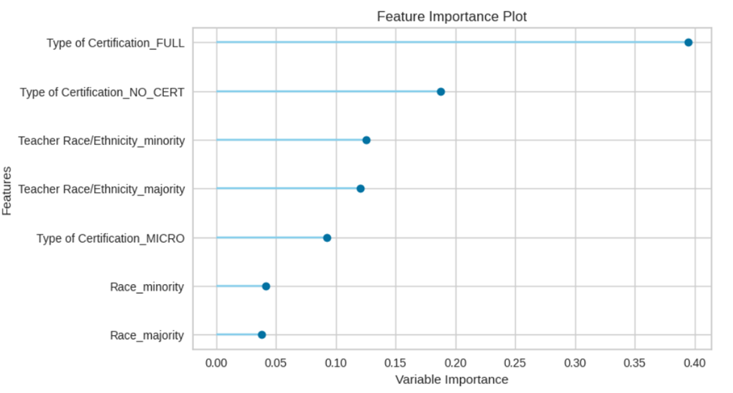
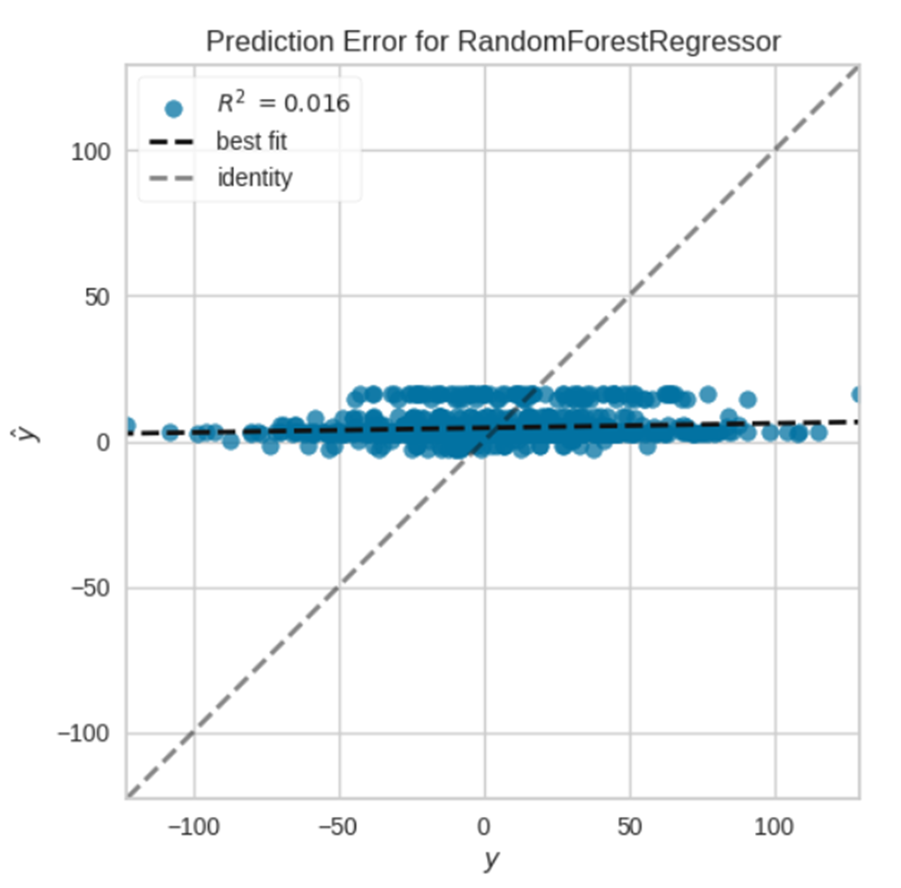
The idea here was to see if we can fit a model to teacher certification and race since the cultural training is catered towards helping students with racial and economic minority
Found that the greatest variable was a full teacher certification, but the fit for the model is super low.

Slide 27
Other Predictors

Slide 28
Stepwise Selection
Type.of.Certification + Teacher.Race.Ethnicity +
Year.of.Certification + Students.with.Disabilities + Race +
Teacher.Highest.Degree + Gender + Teacher.Gender + Teacher.Birth.Year +
Type.of.Principal.Certification
Adjusted R² (0.02439)
Notes:
Stepwise regression is a method used in statistical modeling to select the best subset of predictor variables for a regression model. It involves a systematic process of adding or removing predictor variables from the model based on their statistical significance or contribution to the model's predictive power.

